Slide 1
Pattern Recognition
Deepak Rishi
2010A8PS103G

Slide 2
Most fundamental problem in pattern recognition is if we are given 2 classes of data ,and we are faced with a new data ,we need to assign a class to it.
Thus we need a kind of similarity function to find out a relation between these 2 classes of data and the new data
We employ 2 such similarity factors –
Dot Product
Kernel Function

Slide 3

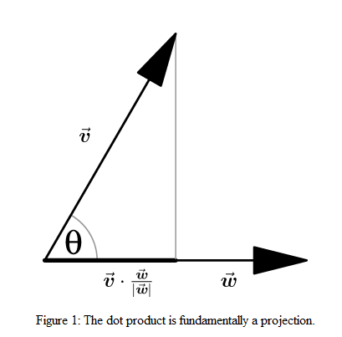
Dot Product
Given that the 2 vectors are of unit length the dot product effectively gives the cosine of the angle between the 2 vectors
Also known as the inner product or the scalar product the dot product of 2 vectors is defined as
The measure of angle gives us an idea of similarity.

Slide 4

Disadvantages of dot product
It is not sufficient for most of the general cases
Patterns might not actually exist in a dot product space
We might have to transform them into a dot product space H,which need not coincide with the real number space
Even if the patterns exist in a dot product space ,we might want to consider general similarity measures by applying a non- linear kernel map phi

Slide 5
VC Dimension and VC bound
The best concept from the VC(Vapnik-Chervonenkis) theory is the concept of VC dimension and VC bound
The VC dimension is defined as the largest m such that there exists a
set of m points which the class can shatter, and infinity if no such m exists.
It can be thought of as a one-number summary of a learning machine’s capacity

Slide 6
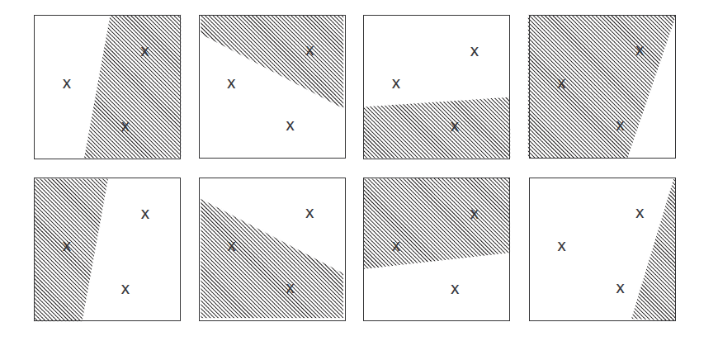
VC Dimension example
The class can assign labels in 2³=8 different ways,i.e. the class can shatter 3 points,hence the VC dimension of the class of separating hyperplane in R² is 3.

Slide 7
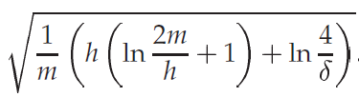
VC bound
If h<m is the VC dimension of the class of learning functions that the class can implement,then for all the functions of that class independent of the generating distribution P with a probability of 1-δ over the drawing of the training sample the bound
R[f]<=R_{emp}[f] + ɸ(h,m, δ )
Where ɸ(h,m, δ ) is

Slide 8
VC bound meaning
Suppose we have a training set and we find a way to find a function that achieves a zero training error ,then to do this the function must need a large VC dimension to shatter all the points correctly ,therefore the confidence term increases monotonically with h,thus this shows that small training error does not gurantee a small test error.

Slide 9

Feature space and kernels
With the non linear mapping phi ,we can define a similarity measure in dot product space H
The function k is called the Kernel function
This allows us to deal with patterns geometrically and
The freedom to choose the mapping Phi allows us to choose a broad range of learning algorithms

Slide 10
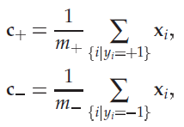
Pattern recognition algorithm
Consider that we have 2 sets of data.We begin by computing their mean’s.Associated with each input x_{i} is a label y_{i} (+1 or -1,for the respective classes)
m₊ and m₋ are the respective number of positive and negative training sets
When we have a new vector x we compute sign of the dot product between <x-c> and <w> ,where c= (c₊ + c₋ )/2
w=c₊ - c₋
The final decision is made depending on weather the angle being enclosed is greater than or less than π/2

Slide 11
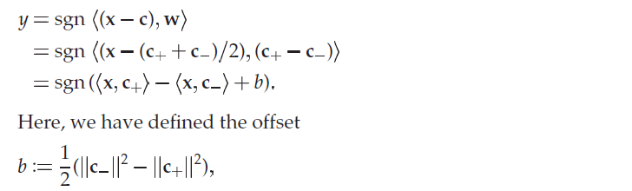
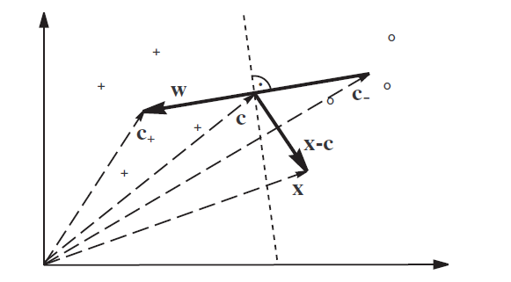
A simple pattern recognition algorithm .Given 2 classes of training set ,we make an prediction on a new dataset based on the dot product of the vectors.

Slide 12
Hyperplane Classifiers and SVM’s
Another classification method is from the use of hyperplanes
The hyperplane equation is <w.x> + b=0
The corresponding descision function is given by f(x)=sgn(<w.x>+b)
The hyperplane is constructed by solving
Ϯ(w)=min(||w||² )/2 s.t. y_{i}(<w.x>+b) >=1 [1<=i<=m]
Since it is a constrained optimization problem ,we use the lagrangian to solve it
L(w,b,α)=||w||²/2 –α_{i} (y_{i}(<w.x>+b)-1)

Slide 13
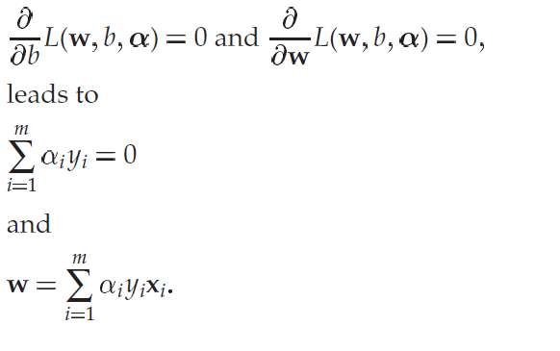
Then the derivatives of the lagrangian with respect to the primal variables must vanish at the saddle point
By KKT conditions α_{i}(y_{i}(<x.w>+b)-1)=0 .So only a few α_{i} are non zero.These non zero α_{i} are called as support vectors.
Eliminating the primal variables we get the dual optimization problem
Max W(α)= _{I} – ( _{I} α_{j} y_{i} y_{j} <x_{i},x_{j}> )/2
Subject to α_{i} >=0 , i=1, …..,m and _{i}y_{i}=0
The hyperplane decision function can thus be written as
F(x) =sgn(_{i} α_{i}<x,x_{i}> +b) ,where x is the input test vector ,and x_{i} is the i^{th} training vector

Slide 14
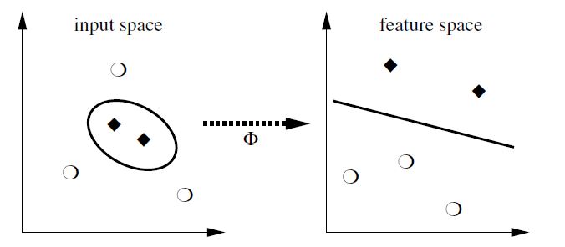
Thus the hyperplane decision function is solely dependent on the non zero support vectors α_{i} making the computation much faster.
The inner dot product can be evaluated with the help of the kernel trick i.e. using a kernel function to the the inner product
The basic idea behind SVM is to map the training data to a higher dimensional feature space via Φ such that the data becomes linearly separable ,then construct a hyperplane to separate it.

Slide 15
Kernels
Basic idea : Construct a mapping from a training set to a higher dimension so that the data becomes linearly separable
Φ : Χ-> Η ,where H is the Hilbert space.
A Hilbert space H is a vector space e ndowed with an inner product and associated norm and metric, such that every Cauchy sequence in H has a limit in H
A sequence of elements x_{n} of a metric space with metric d (.,.) is called a Cauchy sequence if for every ε > 0 there exists an n₀ such that for all k,m > n₀ , d ( x_{k} ,x_{m} ) < ε

Slide 16
Kernel Product features
The reason why kernel functions are so used is that without explicitly finding out the feature mapping to the higher dimensional subset we can find the dot product.
For example lets take the case of monomial features in polynomial classifiers
[X]_{j1} , [X]_{j2} ,[X]_{j3} …….. [X]_{jd}
One way of extracting features is to map to a higher dimension comprising of products of all the d entries.
This is especially useful in visual pattern recognition tasks
Roughly speaking this corresponds to the intuition that an handwritten ‘8’ is an eight only if the product of top and bottom pixel is non zero.

Slide 17
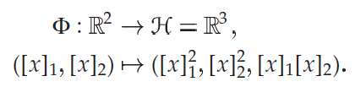

Consider 2 dimensional patterns ,all the monomial feature extractors can be defined as
But for an N dimensional feature vector there exits different monomials of degree ‘d’ .
This is where kernels come to the rescue consider k(x,x’)=<φ(x), φ(x’)> ,i.e. kernels allow us to compute the dot product in H without explicitly having to find the mapping φ.
For eg. Take the case for polynomials N=2,d=2,the map looks like
Where we have considered ordered polynomials ,so x₁x₂ and x₂x₁ are assumed to be different[ to get rid of this multiply them with ]
The dot product in H then looks like

Slide 18
Which is nothing but <x,x’>²
In other words the desired kernel is simply the square of dot product in the input space
This is be generalized to N dimensions will all possible d^{th} order products
K(x,x’)=<C_{d}(x),C_{d}(x’)>=<x,x’>²,where C_{d}(x) consists of all possible entries of the product terms in x.

Slide 19
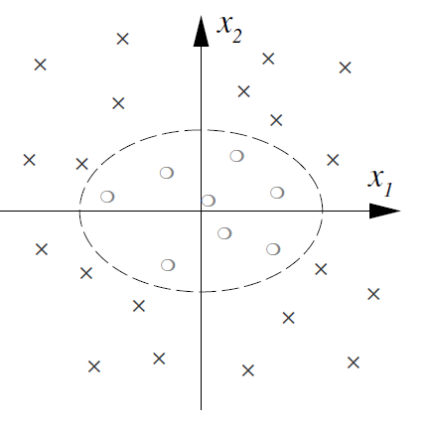
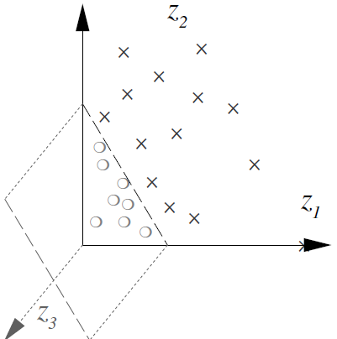
Example for Monomial feature in 2 dimensional
With all this ,it is possible to reduce a non linear separable classification problem to a problem of a separating hyperplane
Consider a dataset in R² in the shape of a ellipse
Where the crosses and circles denote the positive
And negative classes of data.
When mapped into a feature space via a nonlinear
Kernel map φ(x)=(z₁,z₂,z₃) =([x₁]²,[x₂]²,[x₁][x₂]) the data gets transformed to

Slide 20
Kernel Terminologies
Gram matrix : Given a mapping function k: X²->K,the m X m matrix K is called the gram matrix K_{ij}=k(x_{i},x_{j})
Positive definitness : A gram matrix satisfying _{i}c_{j}K_{ij}>=0
The gram matrix of a kernel function is symmetric i.e. k(x_{i},x_{j})=k(x_{j},x_{i})
Cauchy-Schwarz inequality for kernels
If k is a positive definite kernel and x₁ and x₂ ϵ X ,then
|k(x₁,x₂)|² <=k(x₁,x₁)* k(x₂,x₂)

Slide 21
The Kernel Trick
This is one of the most significant properties of kernels
It states that
Given an algorithm formulated in terms of a positive definite kernel ,we can construct an alternate algorithm by replacing that kernel k with another positive definite kernel k’ .
This can be understood from the fact that the dot product values change as the kernel is changed thus changing the algorithm.

Slide 22
Reproducing Kernel Hilbert Space
The dot product space H is called Reproducing Kernel Hilbert Space if it is endowed with the dot product < . , . > and the norm |f|= and satisfies the following properties
k has reproducing property <f,k(x, . )>=f(x)
K spans H
K is unique ,because it is symmetric

Slide 23
Some Important kernels and their applications
Polynomial Kernel : k(x,x’)=<x,x’>^{d}
Gaussian : k(x,x’)= exp(- ||(x-x’)||²/2б²)
Sigmoid : k(x,x’)=tanh(Ҡ<x,x’> +ϑ)
Inhomogeneous kernel : k(x,x’)=(<x,x’>+c)^{d}
The Gaussian kernel can be understood from the fact that its value will be small when the vectors are very different /dissimilar from each other and its value will be large when the 2 vectors are very similar to one another

Slide 24
SVM Code in MATLAB 2012
function [model] = svmTrain(X, Y, C, kernelFunction, ...
tol, max_passes)
%SVMTRAIN Trains an SVM classifier using a simplified version of the SMO
%algorithm.
% [model] = SVMTRAIN(X, Y, C, kernelFunction, tol, max_passes) trains an
% SVM classifier and returns trained model. X is the matrix of training
% examples. Each row is a training example, and the jth column holds the
% jth feature. Y is a column matrix containing 1 for positive examples
% and 0 for negative examples. C is the standard SVM regularization
% parameter. tol is a tolerance value used for determining equality of
% floating point numbers. max_passes controls the number of iterations
% over the dataset (without changes to alpha) before the algorithm quits.
%tol = 1e-3;
eps=1e-5;
max_passes = 10; %the number of max passes are done as we want that a minimum of that many number of passes in which no alpha has changed
m=size(X,1);
n=size(X,2);
alpha=zeros(m,1);
b=0;
E=zeros(m,1);
passes=0;

Slide 25
L=0;
H=0;
W=zeros(1,m);
number_of_changed_alphas=0;
%in this first svm training algo we will select he alpas randonmly
while(passes<max_passes)
for i=1:m
wx=0;
for h=1:m
k=kernal(X(i),X(h),kernelFunction);%kernal function is defined below
wx=wx+ alpha(h)*Y(h)*k; % this is w'x term
end
E(i)=b+wx-Y(i);
if ((Y(i)*E(i) < -tol && alphas(i) < C) || (Y(i)*E(i) > tol && alphas(i) > 0))
while(1)
j=randi(m,1);
if(j~=i)
break
end
end
wx=0;
for h=1:m
k=kernal(X(j),X(h),kernelFunction);%kernal function is defined below
wx=wx+ alpha(h)*Y(h)*k
end
E(j)=b+wx-Y(j);
%saving the old alphas
alpha1=aplha(i);
alpha2=alpha(j)

Slide 26
%finding the upper and lower bounds for alphas
if(Y(i)==Y(j))
L=max(0,alpha1+alpha2-C);
H=min(C,alpha1+alpha2);
else
L=max(0,alpha2-alpha1);
H=min(C,C+alpha2-alpha1);
end
if(L==H)
continue;
end
s=Y(i)*Y(j);
k1=kernal(X(i),X(i),kernelFunction);
k2=kernal(X(j),X(j),kernelFunction);
k3=kernal(X(i),X(j),kernelFunction);
eta=k1+k2-2*k3;
if(eta>0)
alpha(j)=alpha(j)+ Y(j)*((E(i)-E(j))/eta);
if(alpha(j)>=H)
alpha(j)=H;
elseif(alpha(j)<=L)
alpha(j)=L;
else
alpha(j)=alpha(j);
end

Slide 27
else(eta<=0)
f1=Y(i)*(E(i)+b)-alpha(i)*k1-s*alpha(j)*k3;
f2=Y(j)*(E(j)+b)-s*alpha(i)*k3-alpha(j)*k2;
L1=alpha(i)+s*(alpha(j)-L);
H1=alpha(i)+s*(alpha(j)-H);
obj_L=L1*f1+L*f2+(0.5*L1*L1*k1)+(0.5*L*L*k2)+s*L*L1*k3;
obj_H=H1*f1+H*f2+(0.5*H1*L1*k1)+(0.5*H*H*k2)+s*H*H1*k3;
if(obj_L<obj_H-eps)
alpha(j)=L;
elseif(obj_L>obj_H+eps)
alpha(j)=H;
else
alpha(j)=alpha(j);
end
end
if(abs(alpha(j)-alpha2)<eps)
alpha(j)=alpha2;
continue;%because there is no point going further and calculating alpha1
end

Slide 28
alpha(i)=alpha1+s*(alpha2-alpha(j));
%now we update the b paramaters
b1=E(i)+Y(i)*(alpha(i)-alpha1)*k1+Y(j)*(alpha(j)-alpha2)*k3+b;
b2=E(j)+Y(i)*(alpha(i)-alpha1)*k3+Y(j)*(alpha(j)-alpha2)*k2+b;
if(0<alpha(i)<C && 0<alpha(j)<C)
b=(b1+b2)/2;
elseif(0<alpha(i)<C)
b=b1;
elseif(0<alpha(j)<C)
b=b2;
end
%now we update the weight parameters taking only into account linear
%SVM's
W=W+Y(i)*(alpha(i)-alpha1)*X(i)+Y(j)*(alpha(j)-alpha2)*X(j)
number_of_changed_alphas=number_of_changed_alphas+1;
end
end

Slide 29
if(number_of_changed_alphas==0)
passes=passes+1;
else
passes=0;
end
end
model.W=W;
model.alpha=alpha;
model.b=b;
end
function [kernal_value]=kernal(x1,x2,kernelFunction)
ktmp=0
if(strcmp('linearKernel',kernelFunction)==1)
ktmp=x1'*x2;
elseif(strcmp('gaussianKernel',kernelFunction)==1)
sigma=10;
[m n]=size(x1);
for i=1:n
u=(x1(m,i)-x2(m,i))*(x1(m,i)-x2(m,i));
ktmp=ktmp+exp((-1*u*0.5)/(sigma*sigma));
end
else%default kernal function is linear kernal
ktmp=x1'*x2;
end
kernal_value=ktmp;
end

